Slide 1
Orthopedic Care For Gunshot Cases in HGH
Dr Ahmed Saed Ali
Orthopedic and Trauma specialist
Head of Orthopedic Department

Slide 2
Introduction
war surgery is very different from that practiced in peacetime, when most operations are elective and most trauma is blunt, and the surgeon concentrates on doing everything he possibly can – using the full range of resources necessary – for each and every patient.
standard medical ethics: international humanitarian law, or the law of war
this should be thought the medical Staff

Slide 3
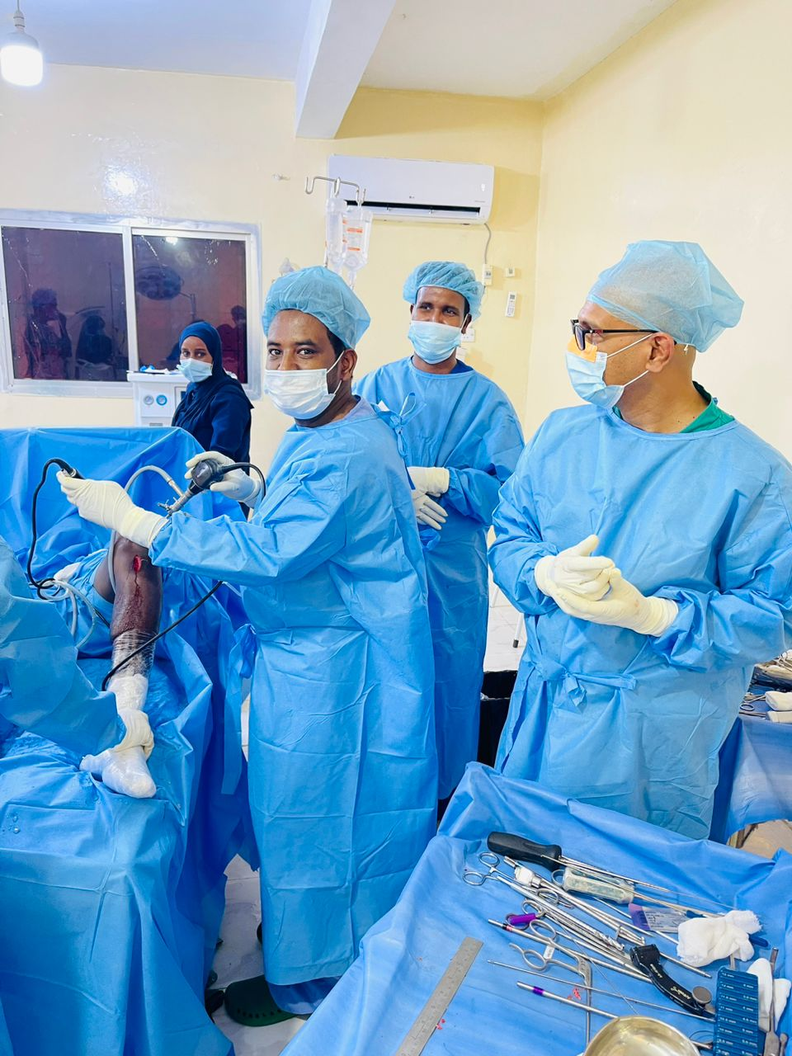
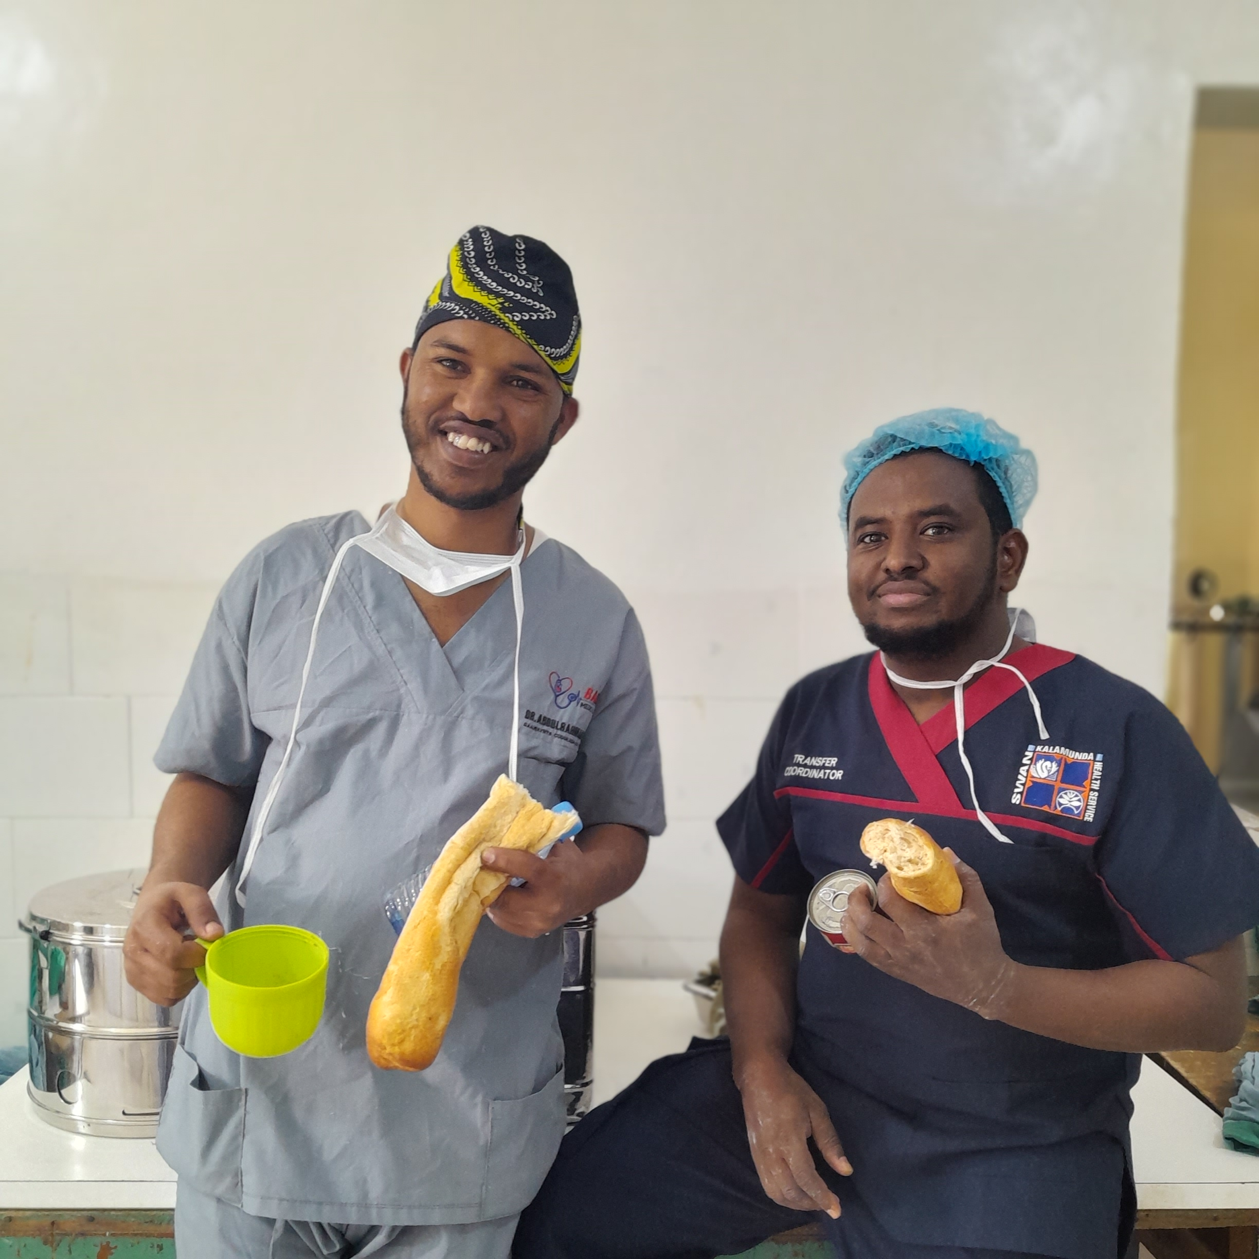
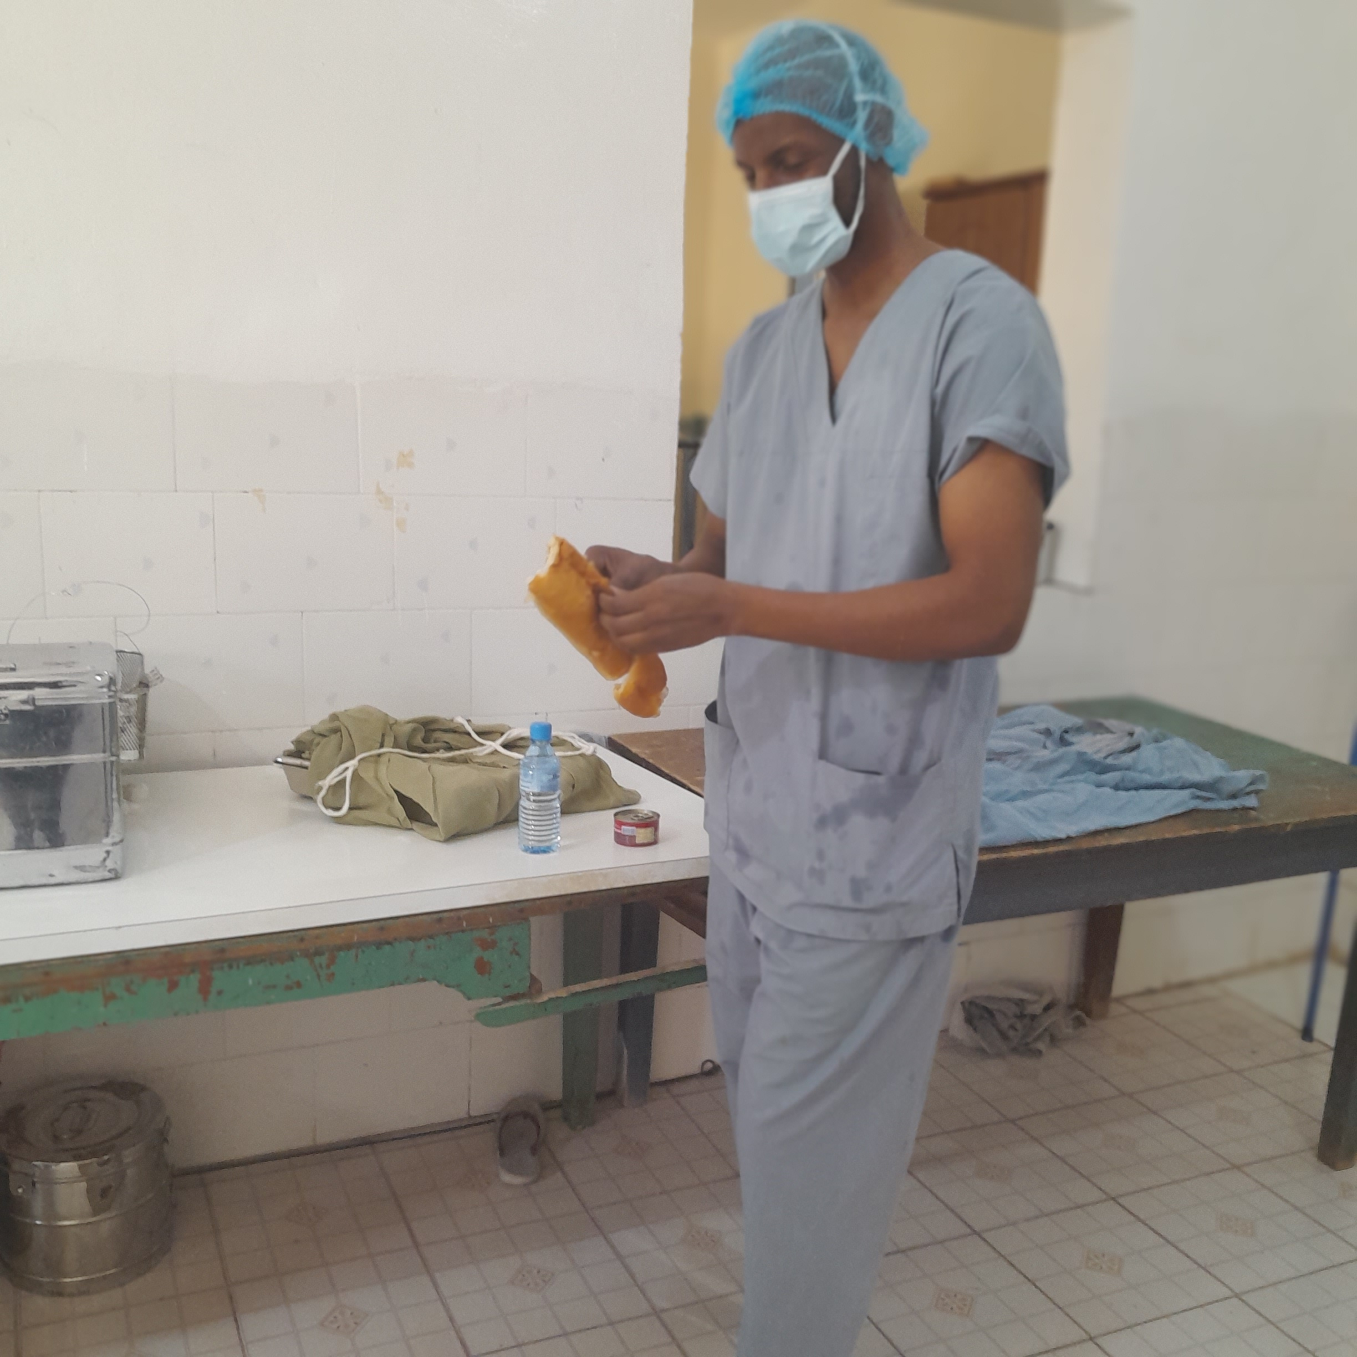
Differences between surgery in times of conflict and civilian practice

Slide 4
mechanisms of Gunshot injuries
Blunt injury in war:
Road traffic crashes
Collapsed buildings and fall
Explosions and anti-tank mine
3.1.2 Penetrating wounds caused by weapons of war :
Bullet Wound
Fragments Wound

Slide 5
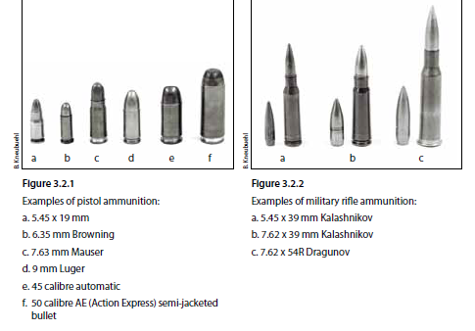

Slide 6
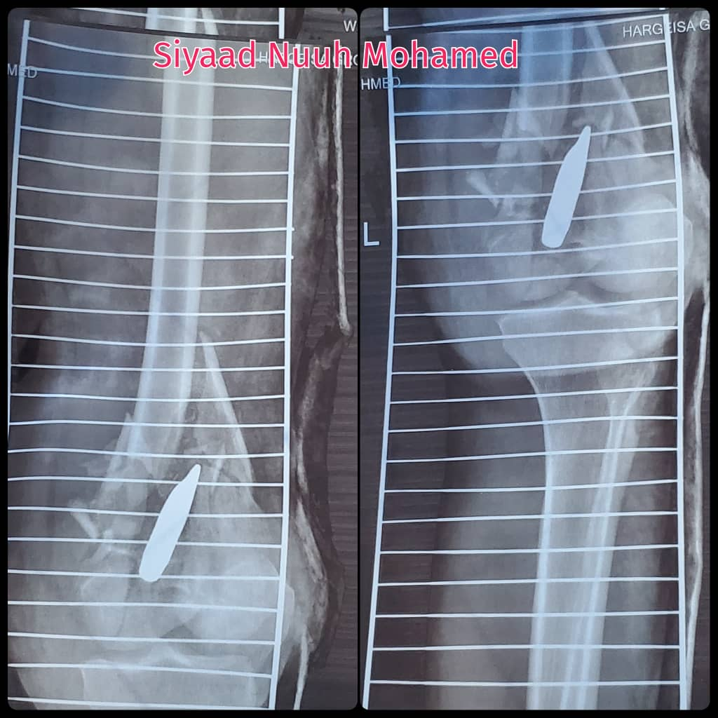
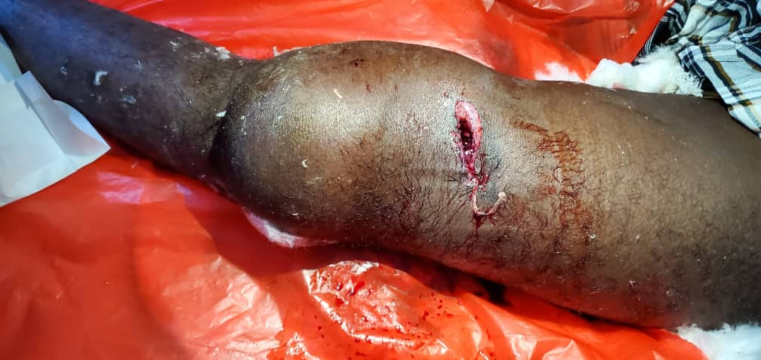
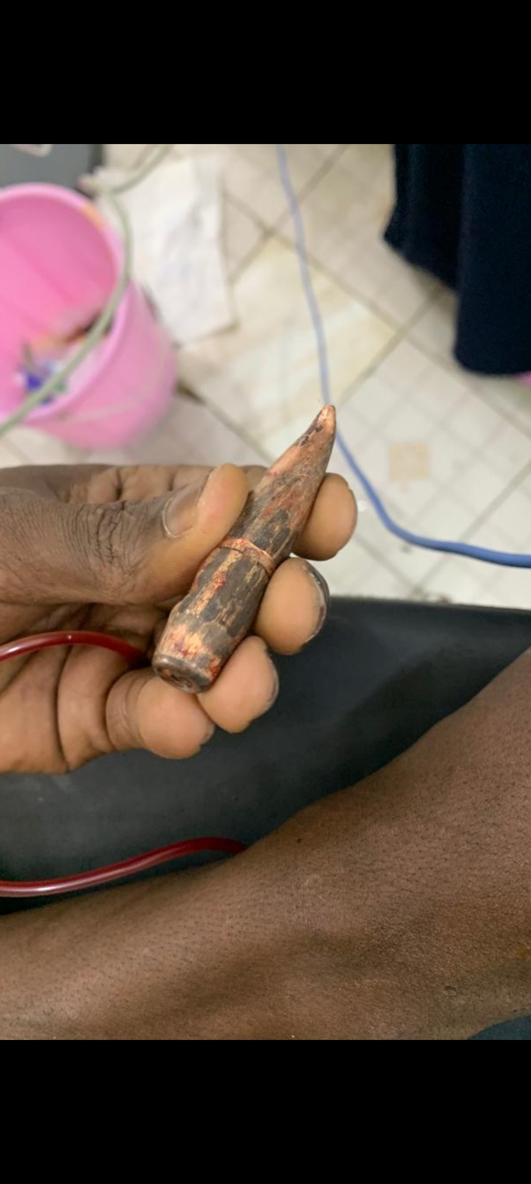
Pre-operation

Slide 7
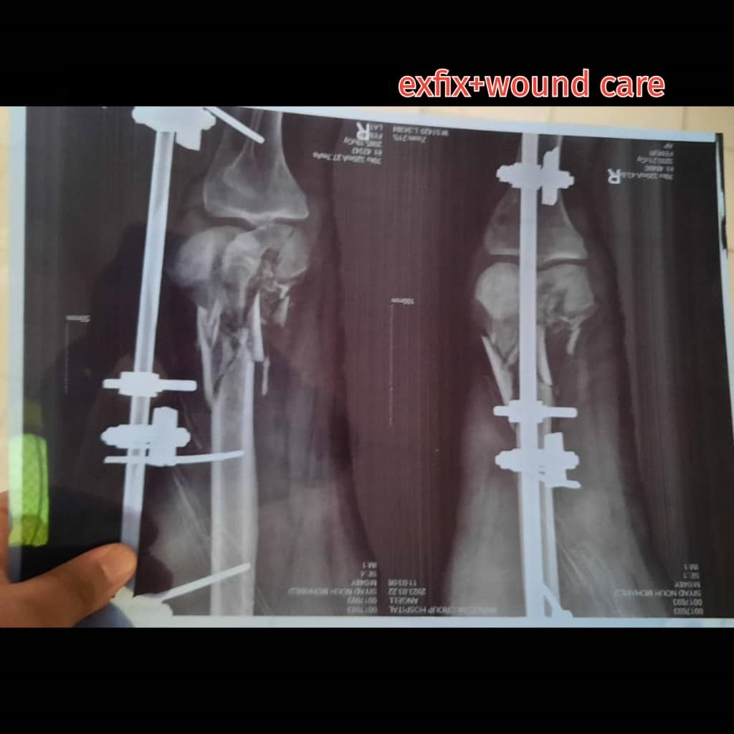
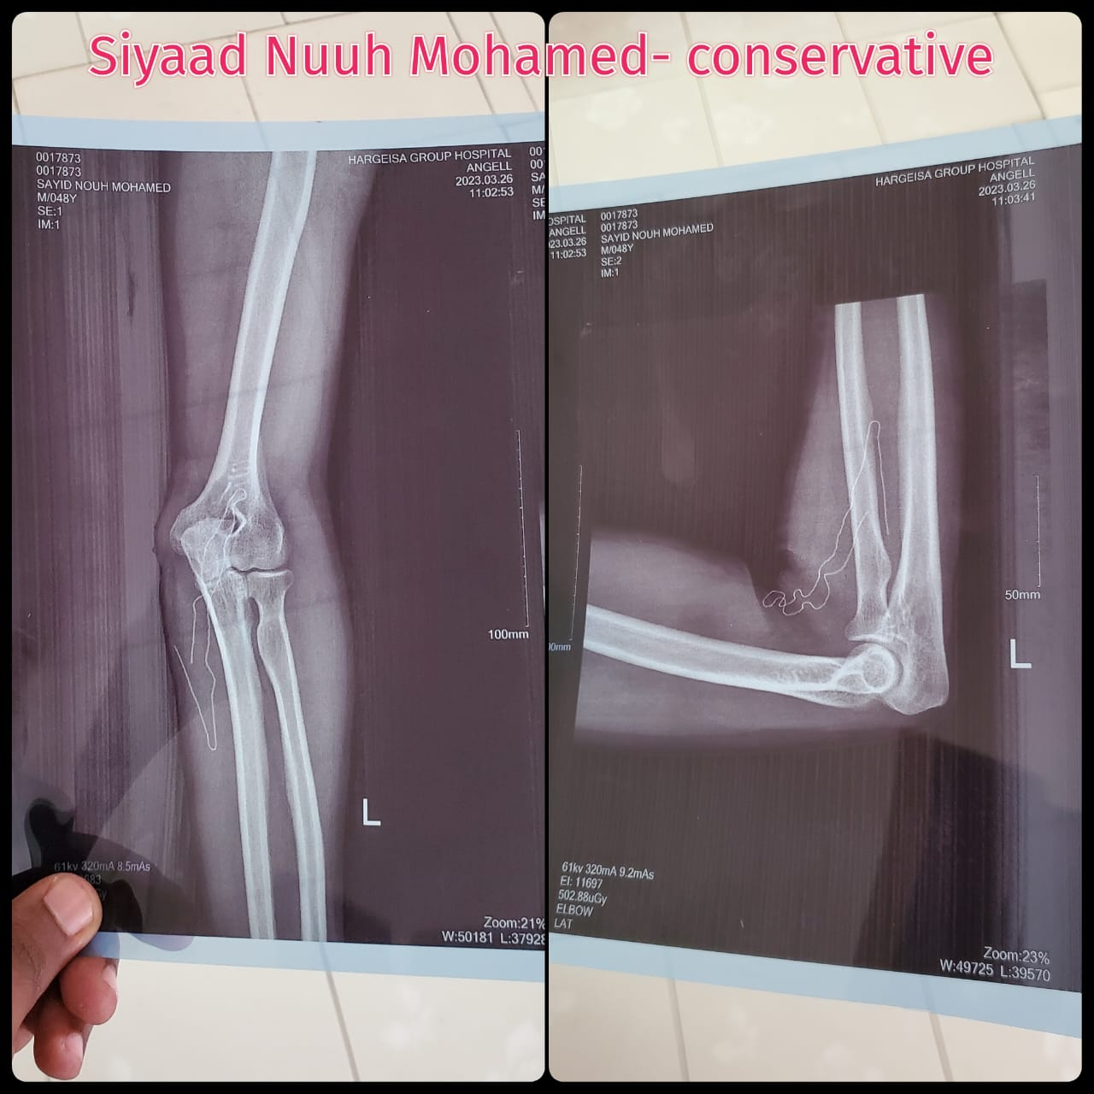
Post-Operation

Slide 8
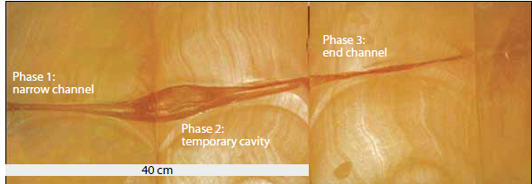

Slide 9
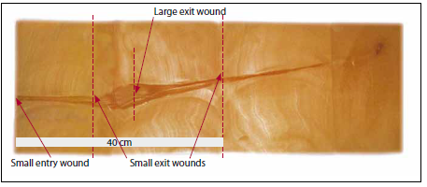
Small Entry and Small Exit
Small Entry and Large Exit
Small Entry and Small Exit

Slide 10
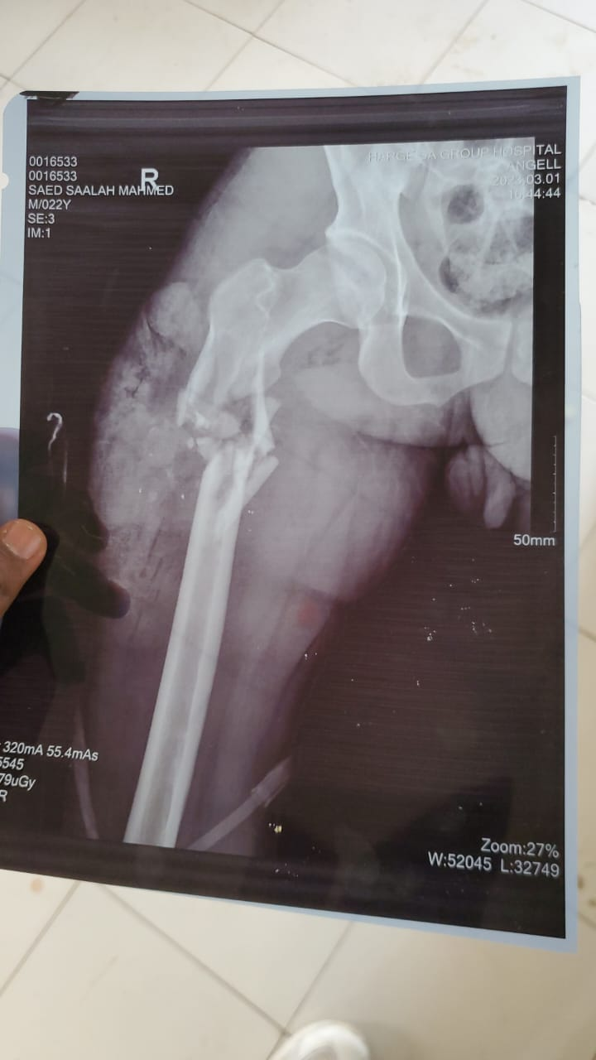

Pre operation

Slide 11
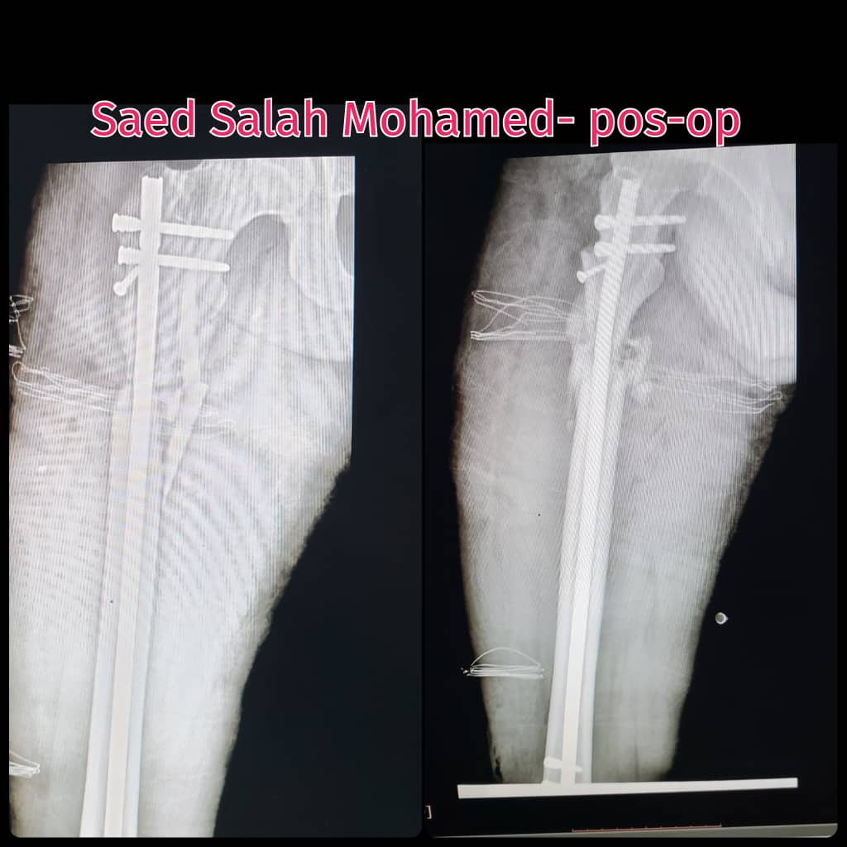
Post-operation

Slide 12
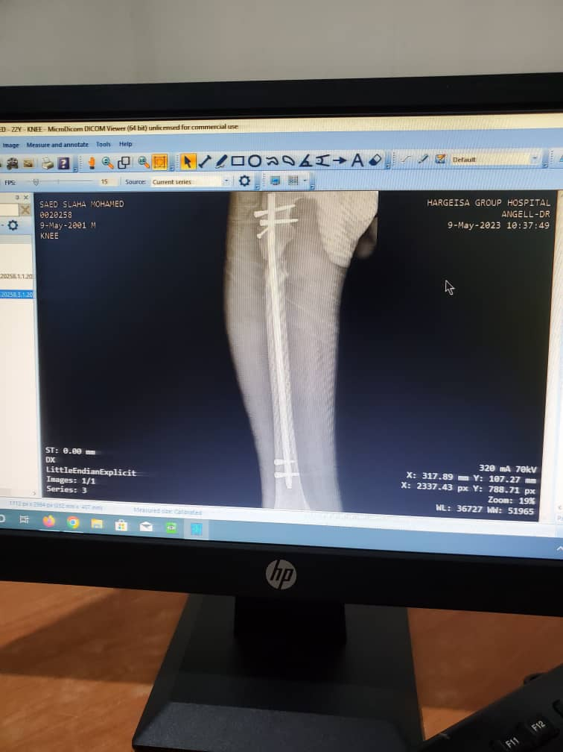
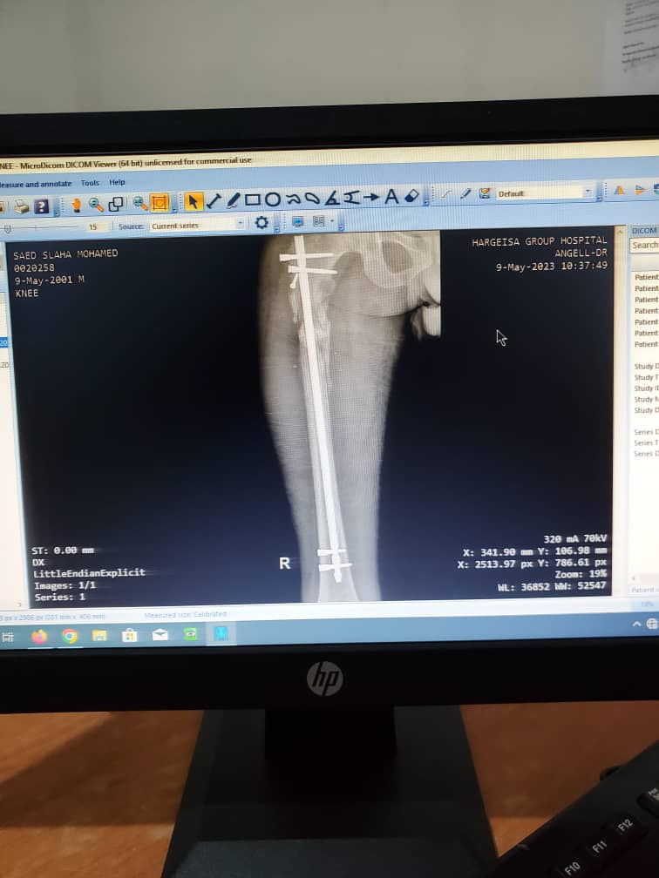
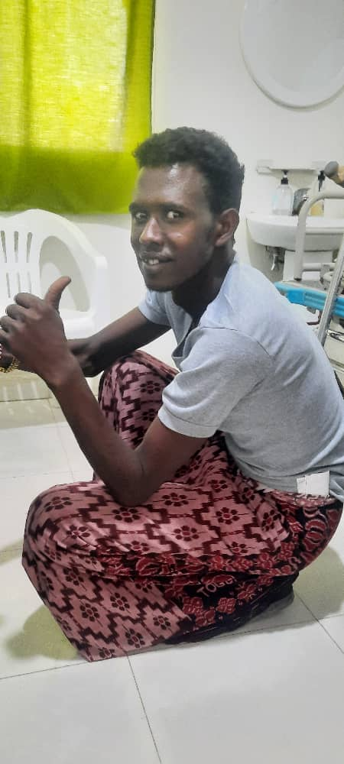

Slide 13
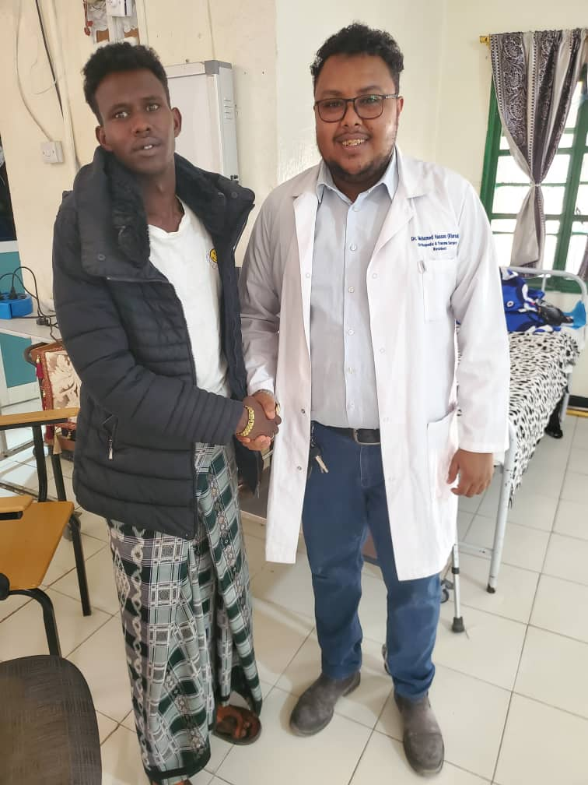

Slide 14
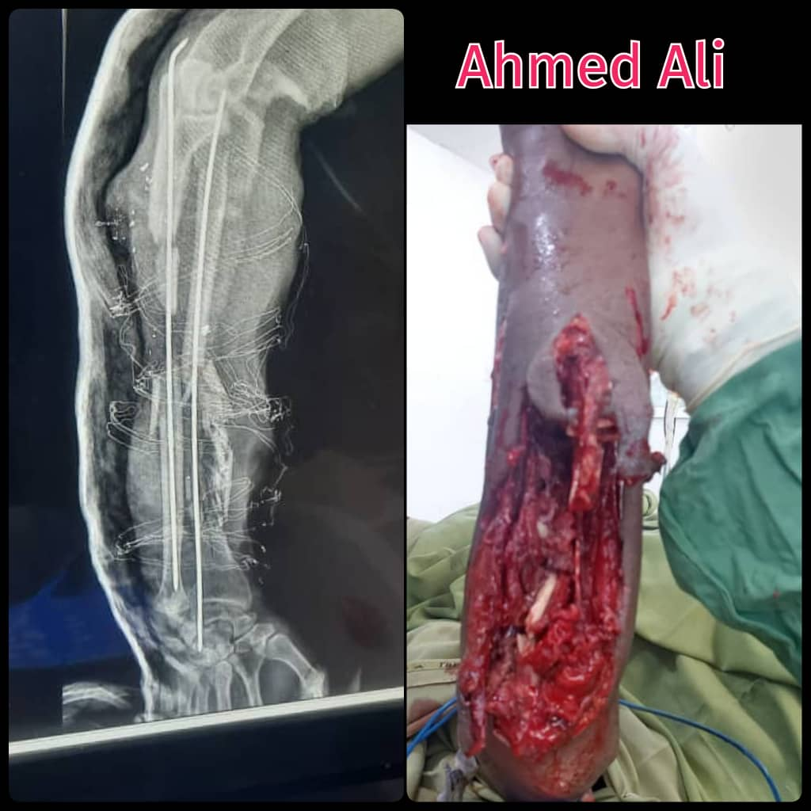
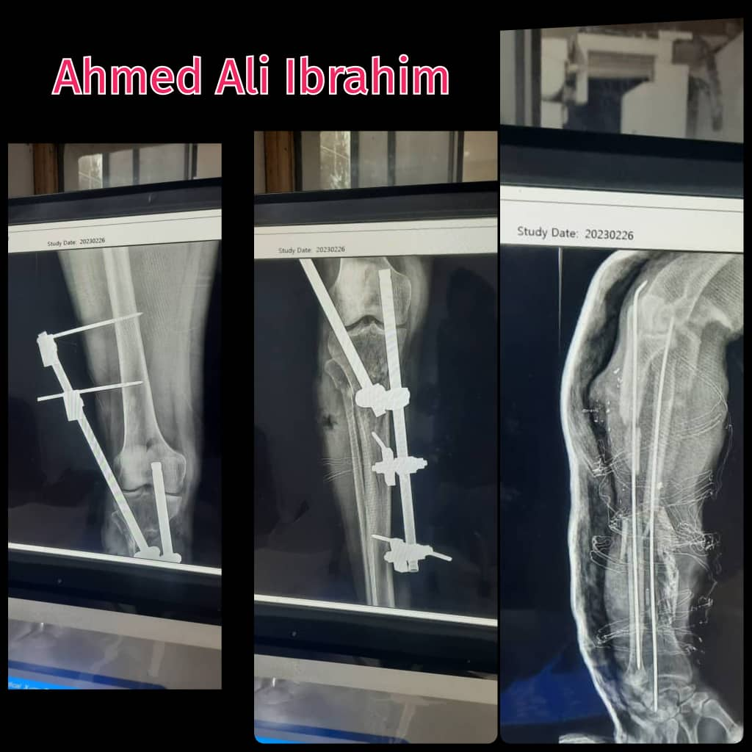
Small entry- large exit

Slide 15
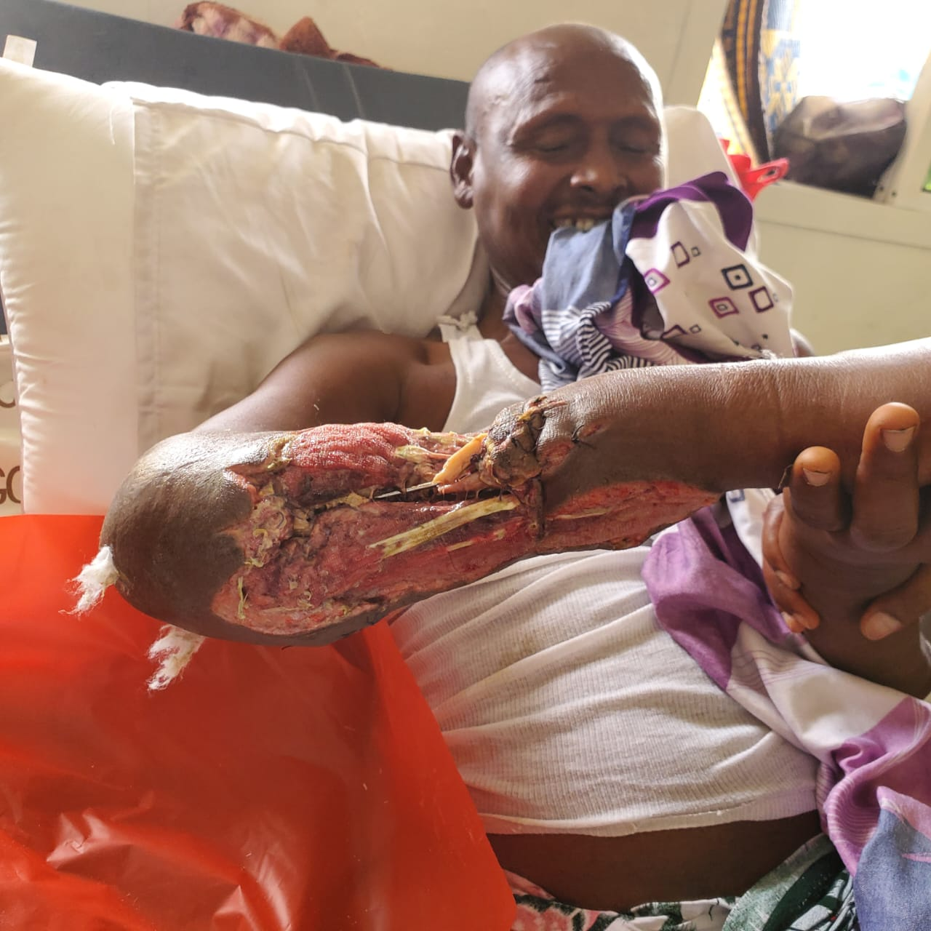
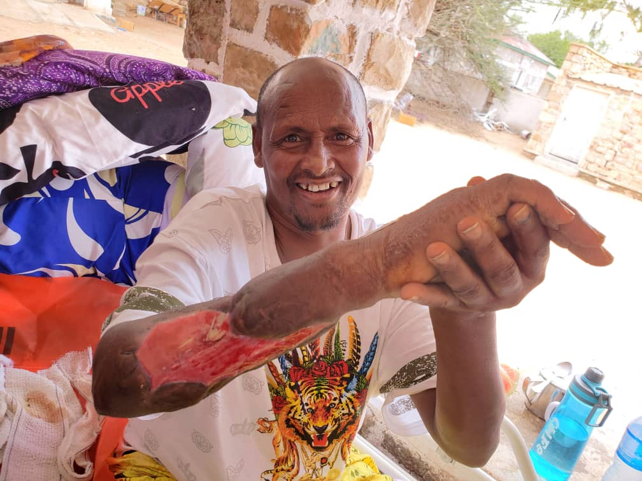
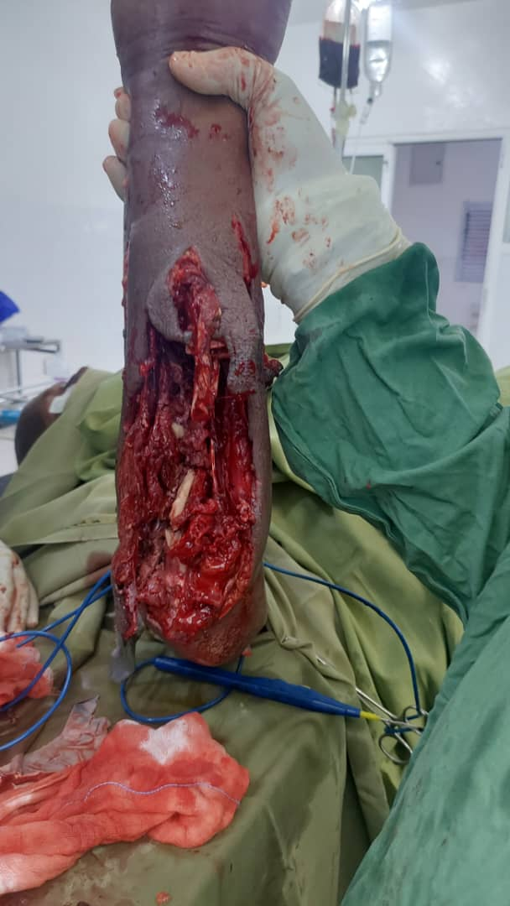
small entry- large exit

Slide 16
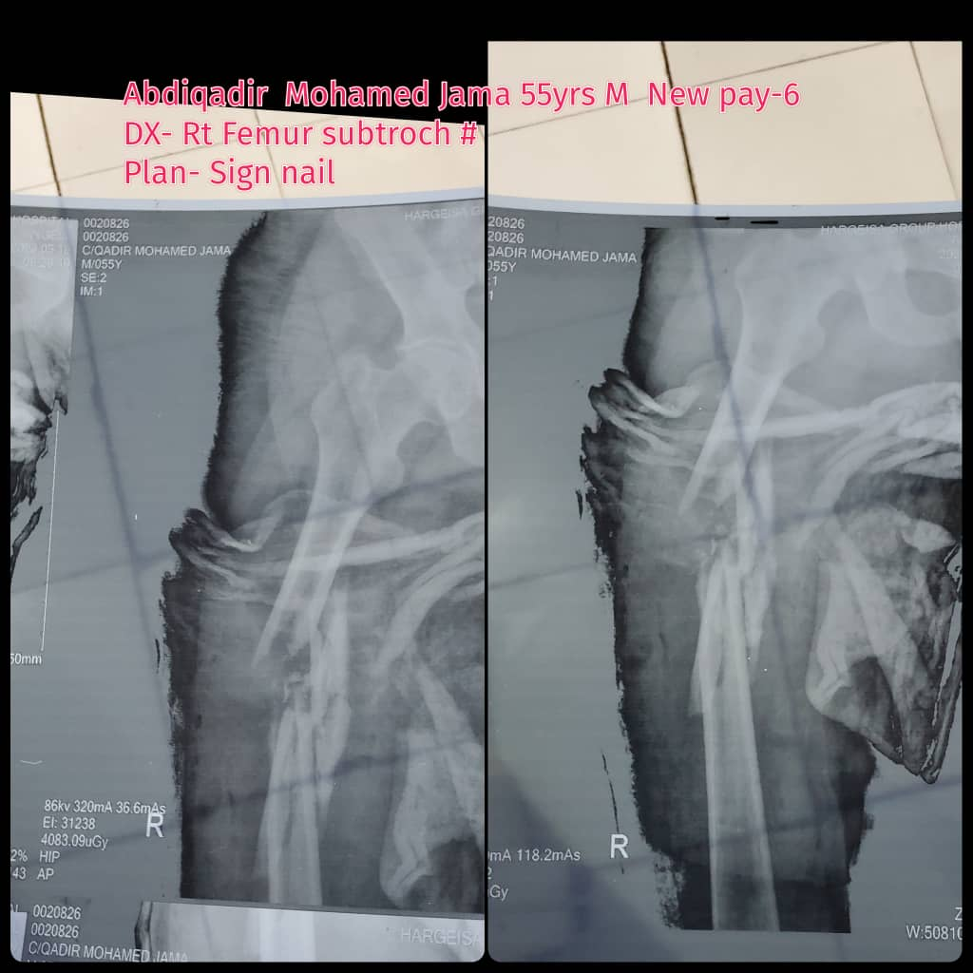
S mall Entry – Small Exit

Slide 17
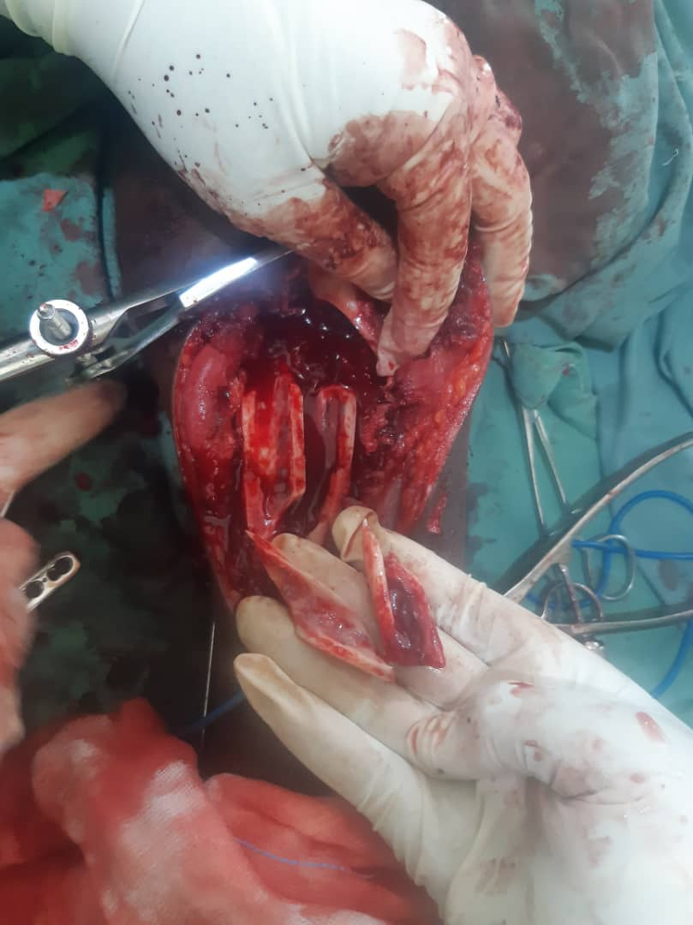
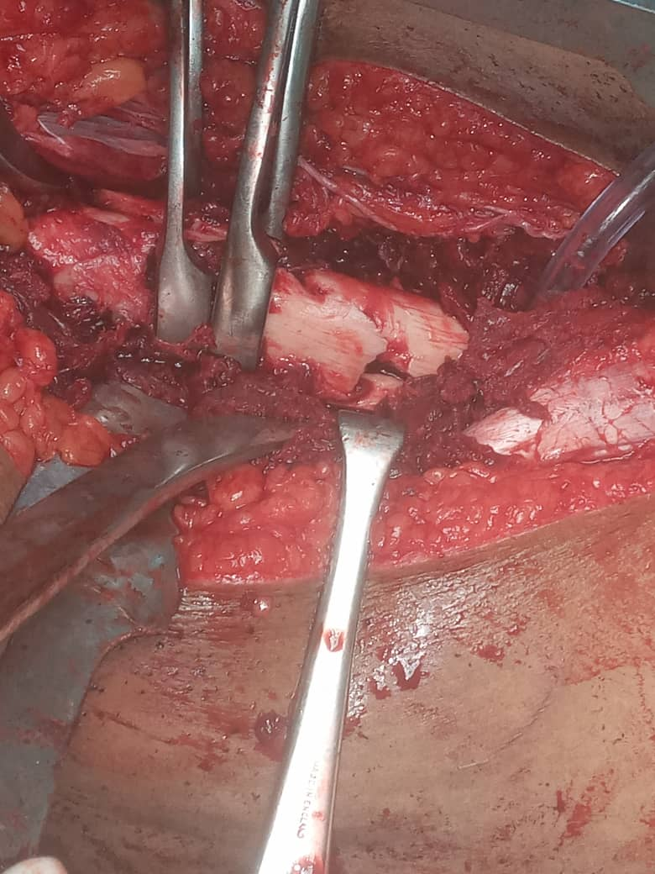

Slide 18
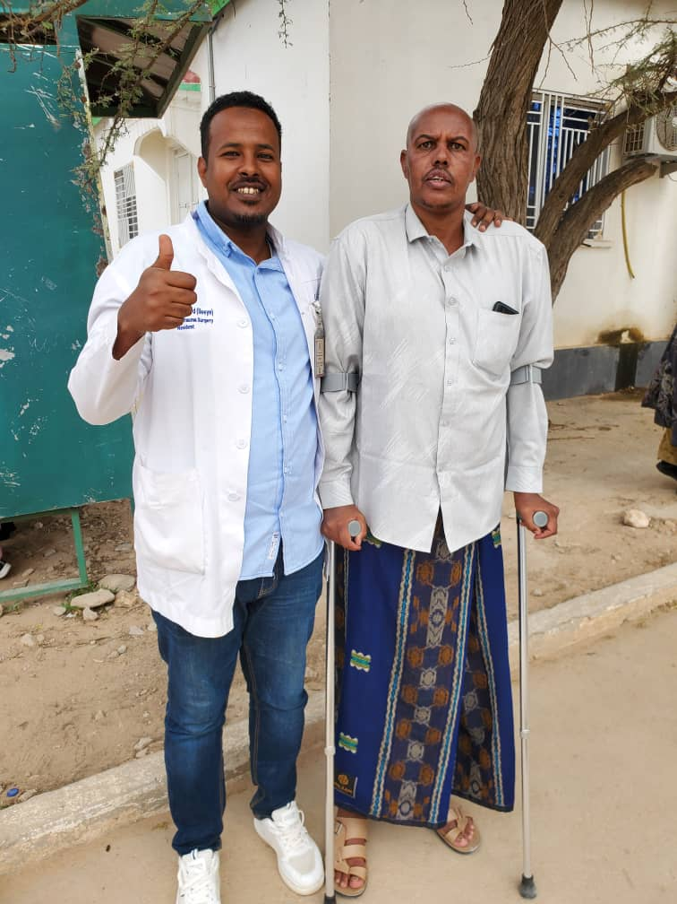

Slide 19
Bullet Fragments

Slide 20
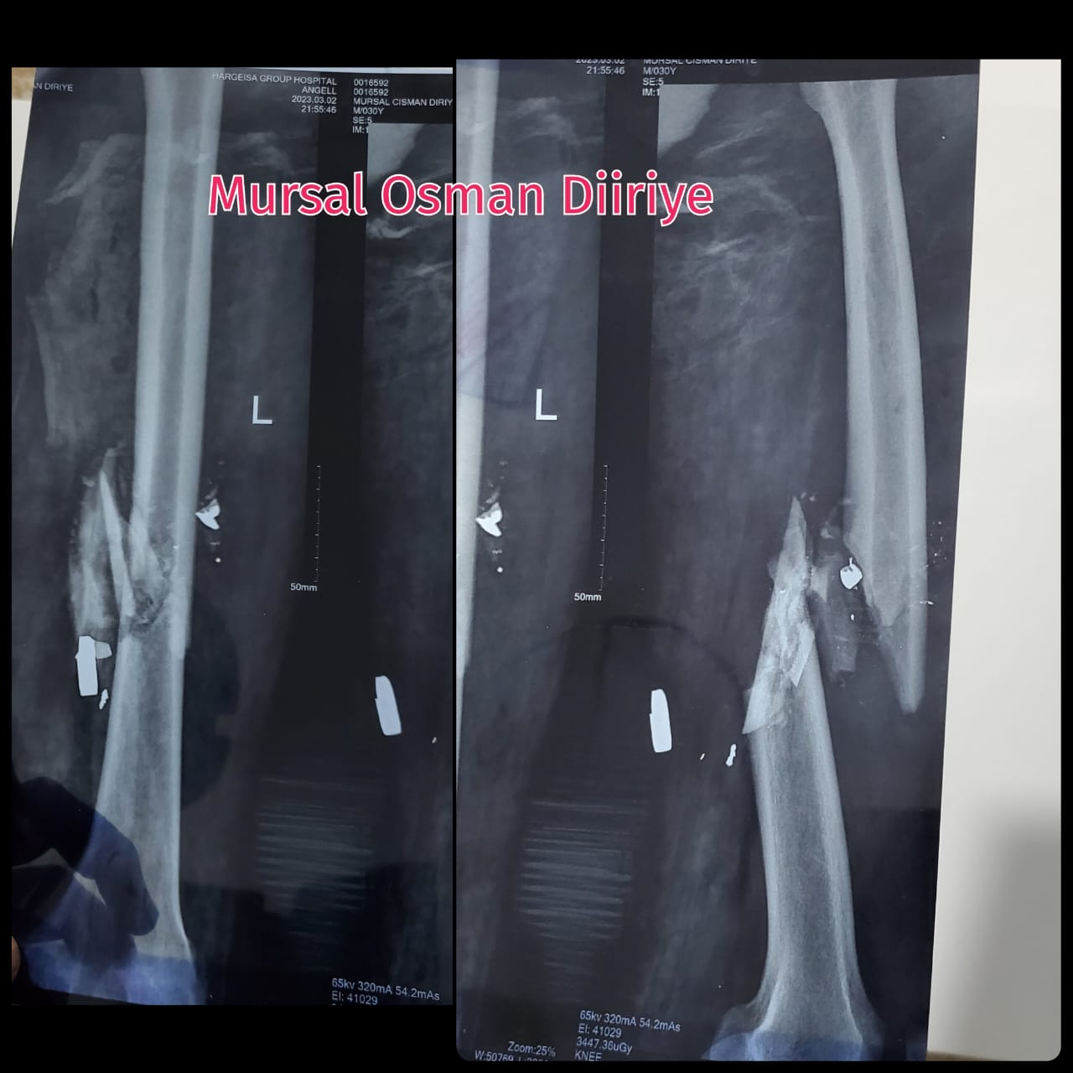
Pre-operation

Slide 21
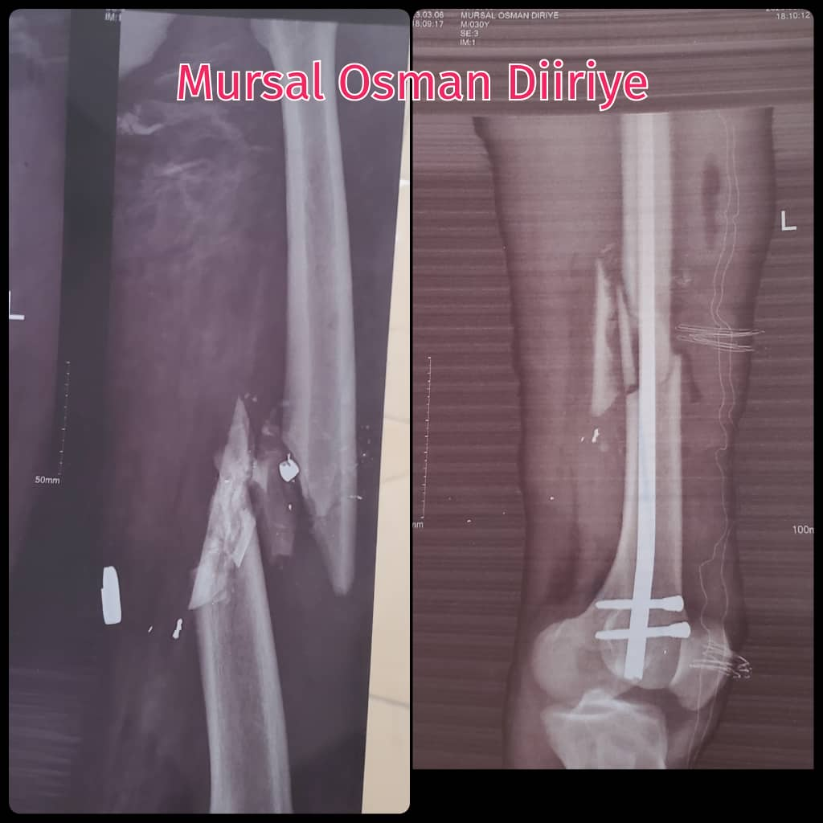
Post-operation

Slide 22
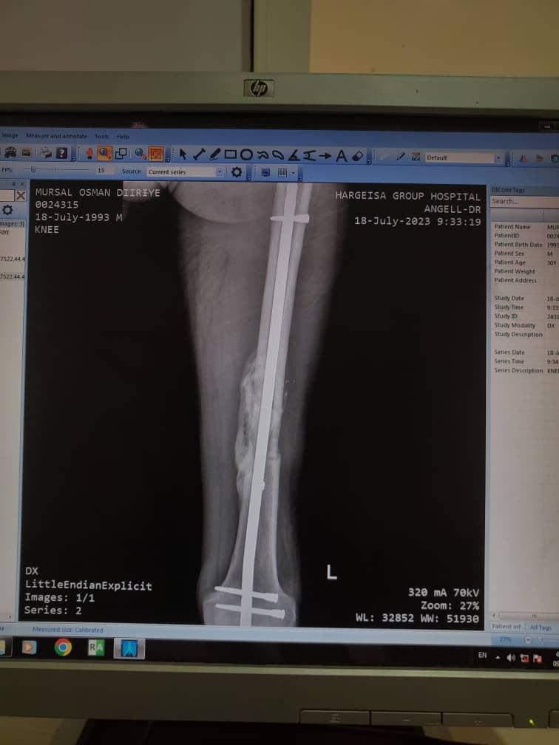
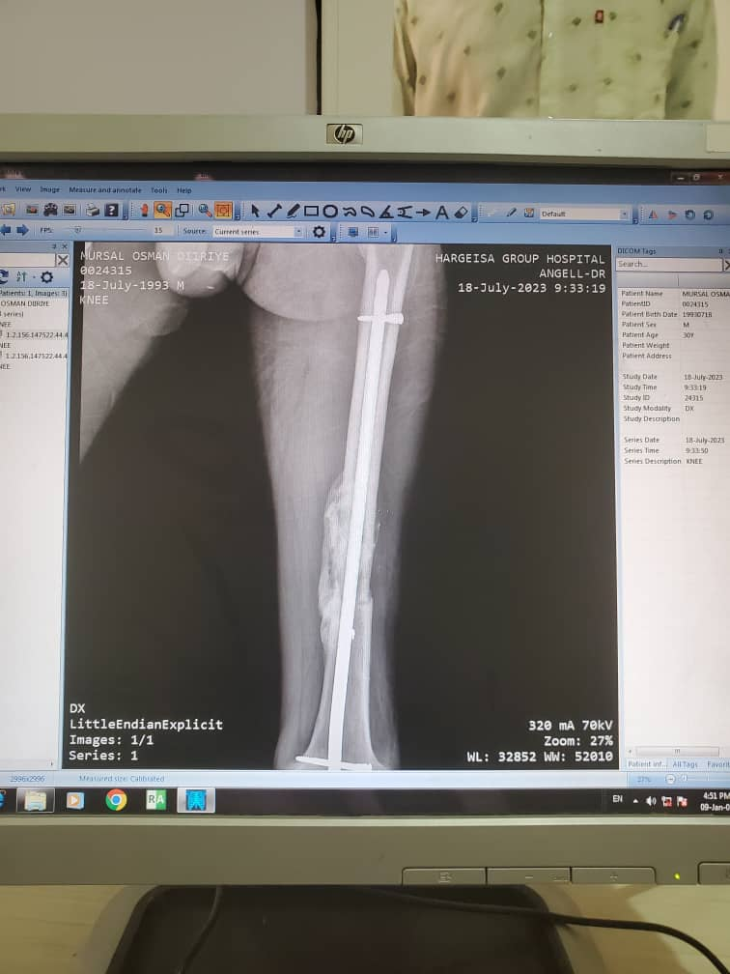
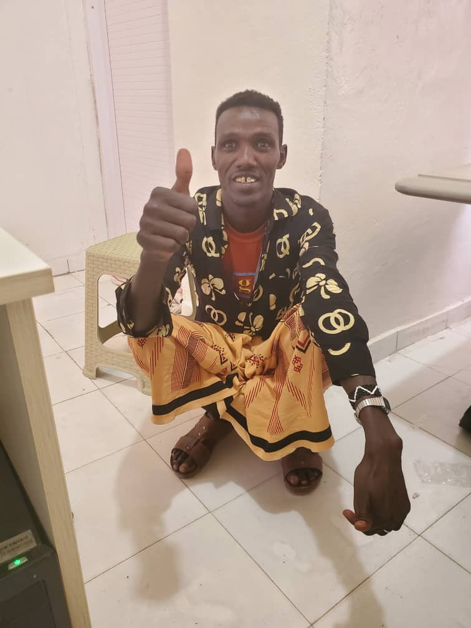

Slide 23
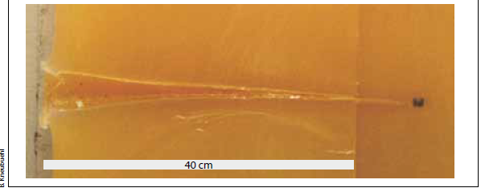
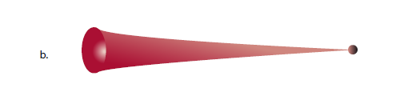

Slide 24
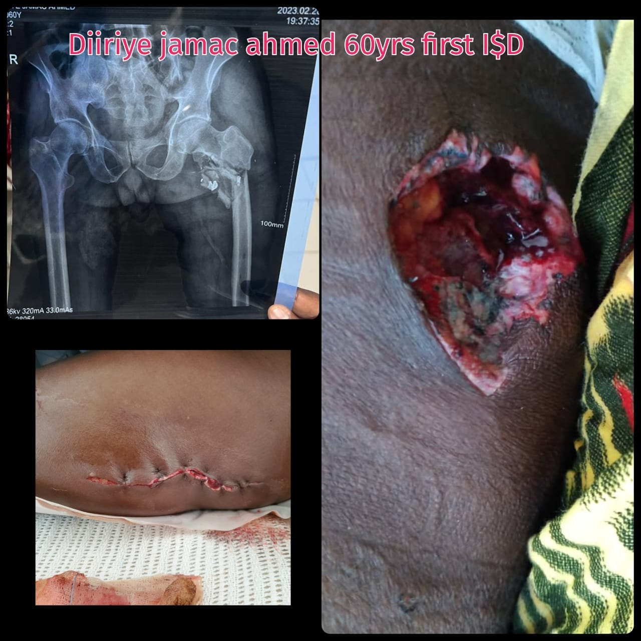
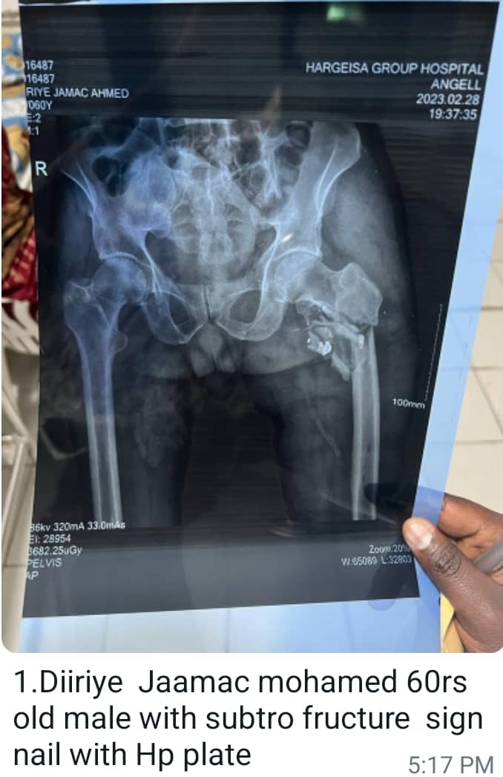
Pre-operation

Slide 25
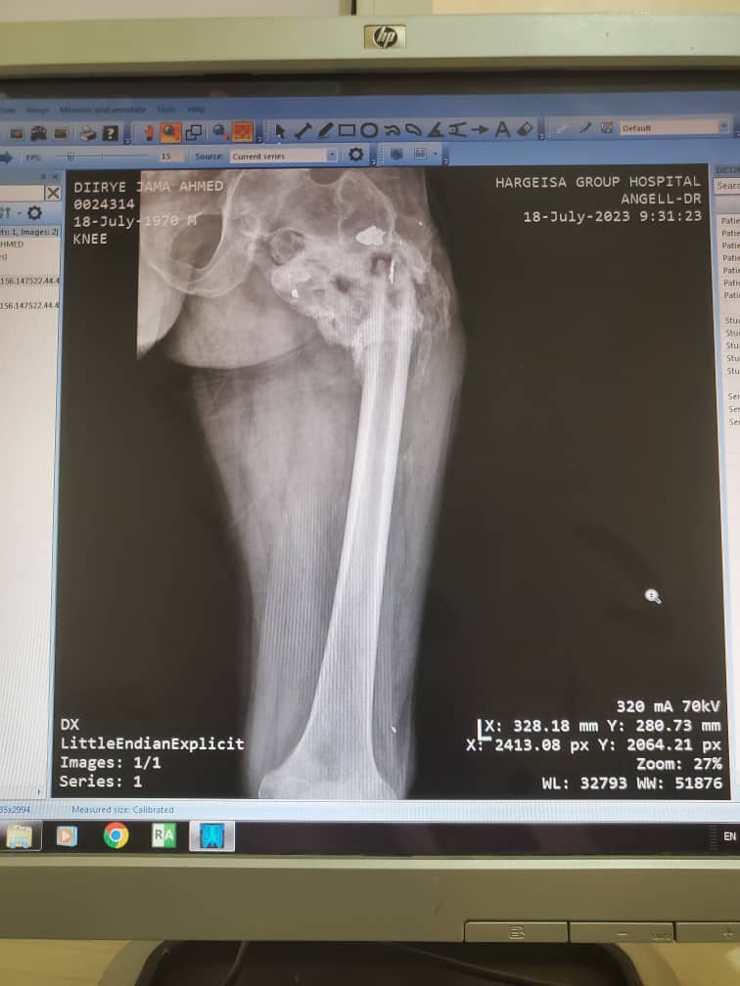
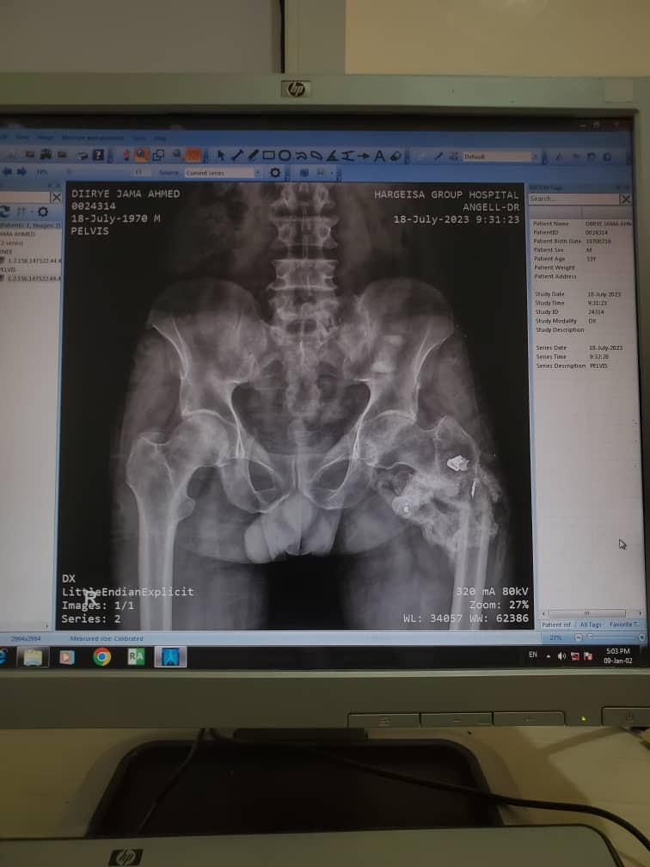

Slide 26
Intra –articular fragments should be removed

Slide 27
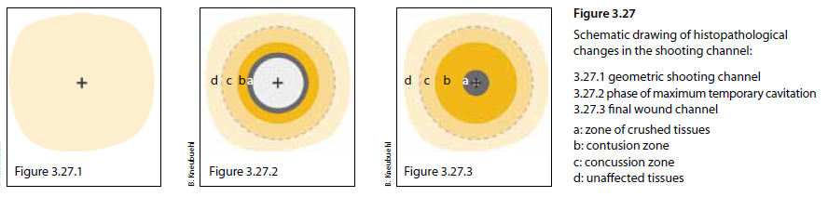
Damage is beyond what you see

Slide 28
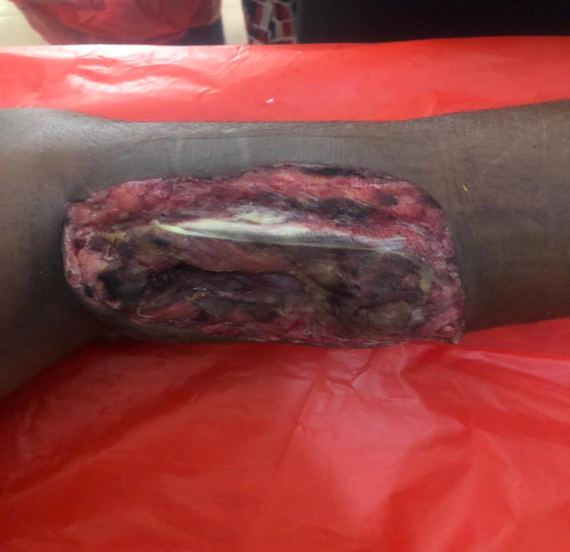
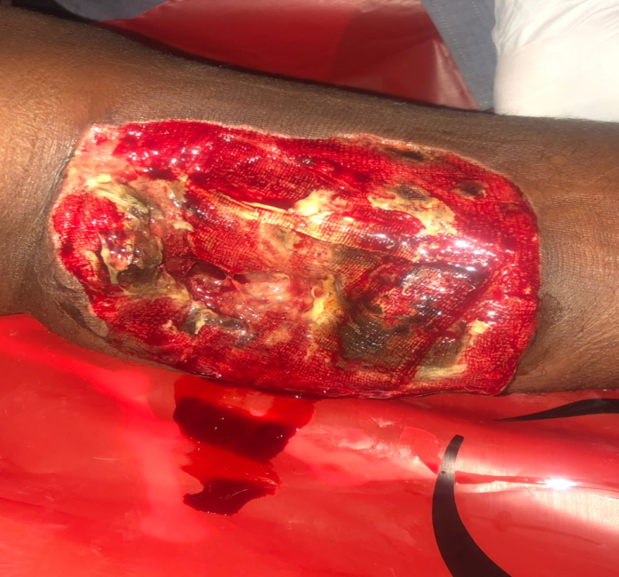
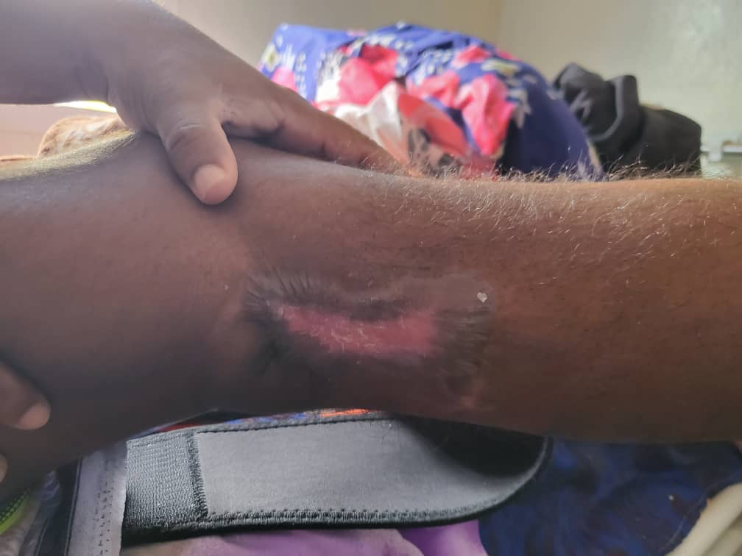
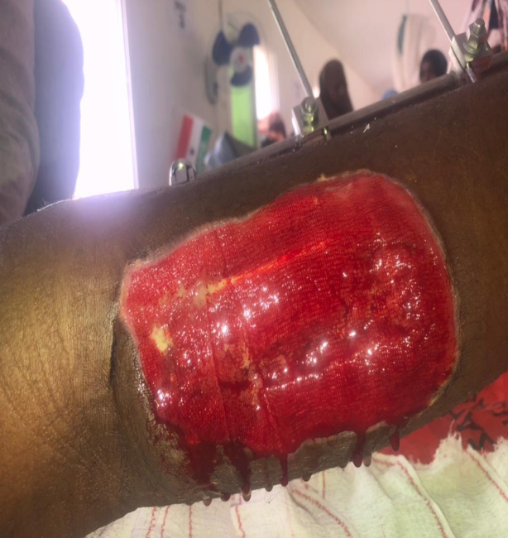
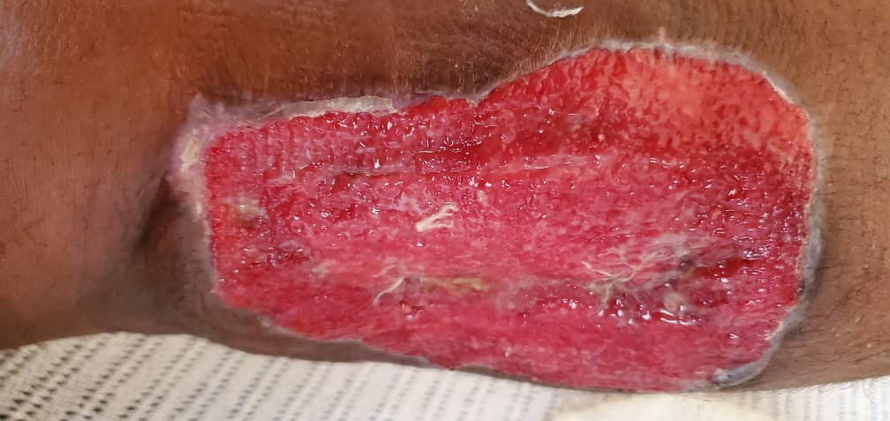
Post-operation

Slide 29
Principles Of gunshot wound management
1 Early and thorough wound excision and irrigation.
2. Adequate wound drainage.
3. No unnecessary dressing changes.
4. Delayed primary closure.
5. Antibiotics as an adjuvant.
6. Anti-tetanus vaccine and immunoglobulin if necessary
7. No internal bone fixation.(honey moon period )
8. Early physiotherapy

Slide 30
Total number of Gunshot patient got injured and admitted to Hargeisa group hospital department of orthopedic and trauma surgery are 350 patients

Slide 31
Total number of operated cases was 271 patients.

Slide 32
Anatomic Region of Injury

Slide 33
Levels and locations of medical care
1. On the spot: first aid.
2. Collection point: first aid with/without resuscitation.
3. Intermediate stage: resuscitation with/without emergency surgery.
4. Surgical hospital: primary surgical treatment.
5. Specialized centre: definitive surgical treatment including reconstructive procedures; physiotherapy and rehabilitation, both physical and psychological.
6. Transport system for transfer from one echelon to another.
Notes:
Ciidanka qudhiisa waa inaan qaarkood u tobaba barno inay first Aid ka sameyn karaan oo qaar dagaalka kujira barno basic nurse sida yuhuuda ,
Waxaan waydiiyay maxa baabuur laydinka qabsan waaya waa wada darawal , inagoo ka faaidaysanaynaa khibradaa aan wada nursena ka dhigno

